Slide 1
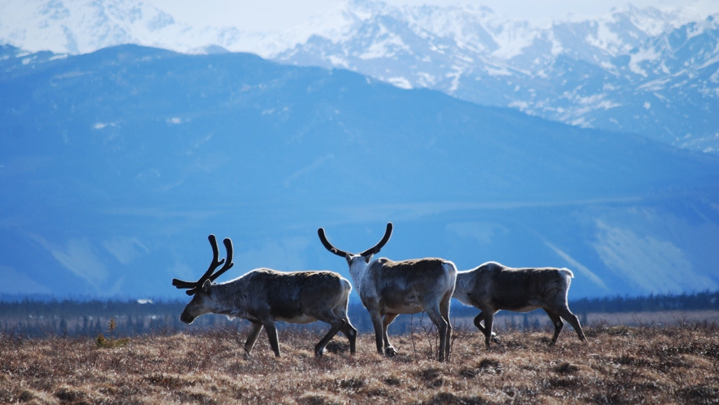
Arctic Boreal Vulnerability Experiment (ABoVE)
2019 ABoVE Airborne Flights
15 July 2019 (DOY 196)
AVIRIS-NG: Peace-Athabasca Delta
Charles Miller, Deputy Science Lead
Jet Propulsion Laboratory, California Institute of Technology
and the ABoVE Science Team For Hank Margolis, Mike Falkowski, Bruce Tagg, Jack Kaye
NASA HQ
2019

Slide 2
15 July 2019/DOY 196 Peace-Athabasca Delta
Daily Status:
AVIRIS-NG / Dynamic Aviation B-200 (N53W)
REPORT DATE: 15 July 2019
Current Status of Aircraft: GREEN
Current Status of AVIRIS: GREEN
Current Deployment Location: Yellowknife NT (CYZF)
Crew: M Drowley (PIC), C McCann, M Helmlinger, J Chapman
Science Planning: A Thorpe
Data Processing: W Olsen-Duvall
Instrument Manager: M Eastwood
Instrument PI: R Green
Science Lead: C Miller

Slide 3
15 July 2019/DOY 196 Peace-Athabasca Delta
Daily Summary:
Mostly clear with some high cirrus
Flew first 8 lines of PAD grid
Burman-Smith-Pavelsky team on the water making simultaneous measurements in NE PAD

Slide 4
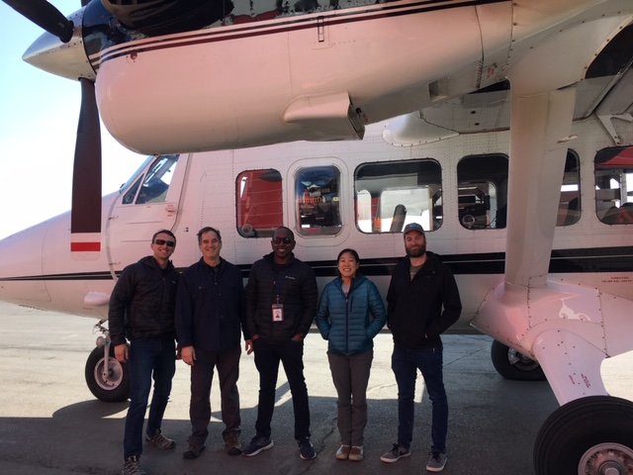
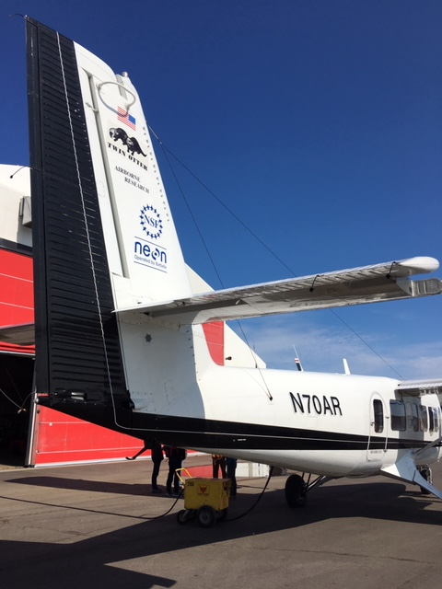
15 July 2019/DOY 196 Peace-Athabasca Delta
Update
Notes:
AVIRIS & NEON teams in Barrow

Slide 5
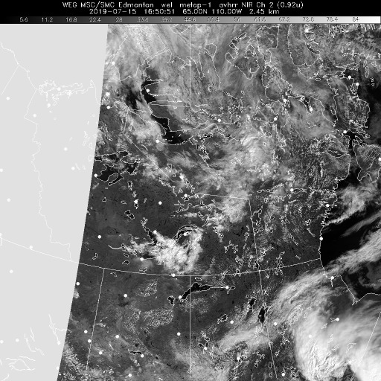
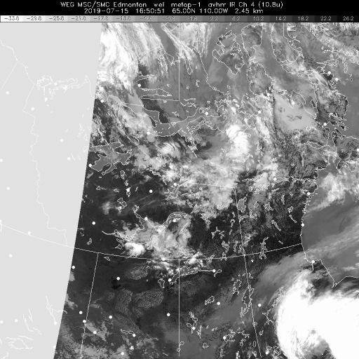
15 July 2019/DOY 196 Peace-Athabasca Delta
Vis 1650Z
IR 1650Z
Notes:
Clear cell over the Scotty Creek – Fort Liard area

Slide 6
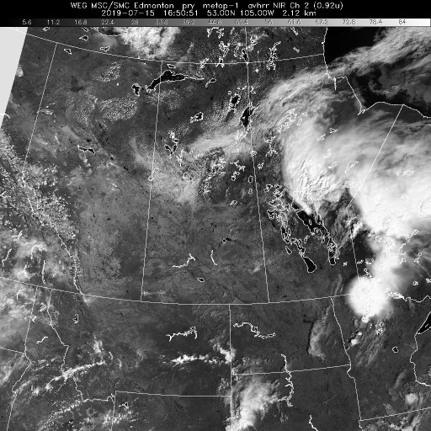
15 July 2019/DOY 196 Peace-Athabasca Delta
3 um 1650Z
Notes:
Clear cell over the Scotty Creek – Fort Liard area

Slide 7
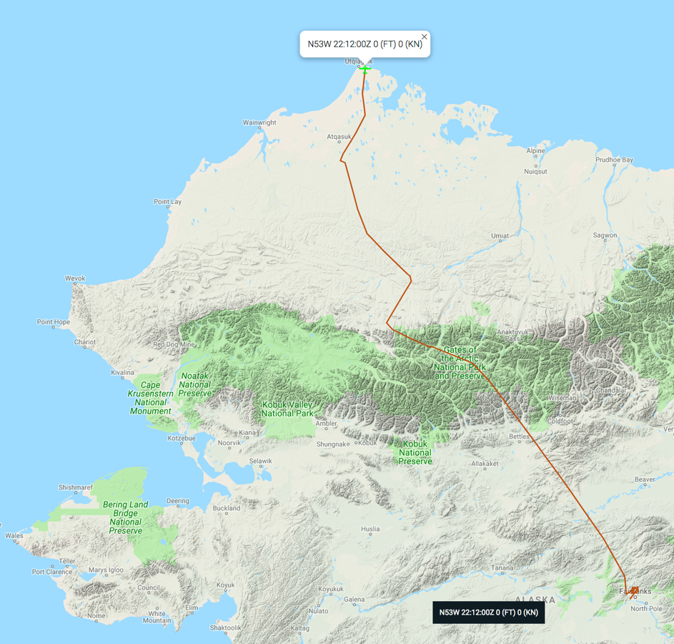
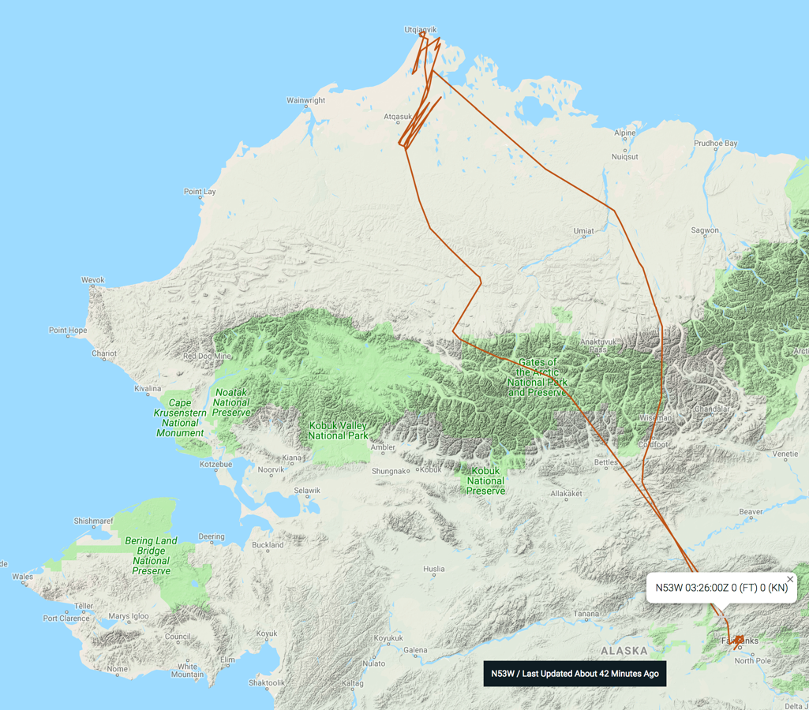
15 July 2019/DOY 196 Peace-Athabasca Delta
Leg 1
Leg 2
Update
As-Flown Lines

Slide 8
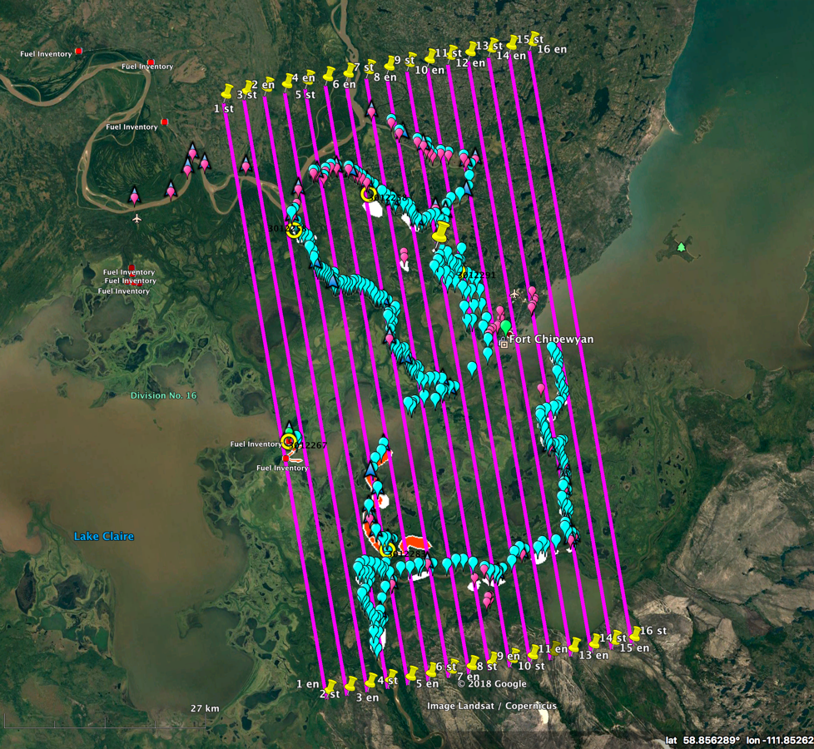
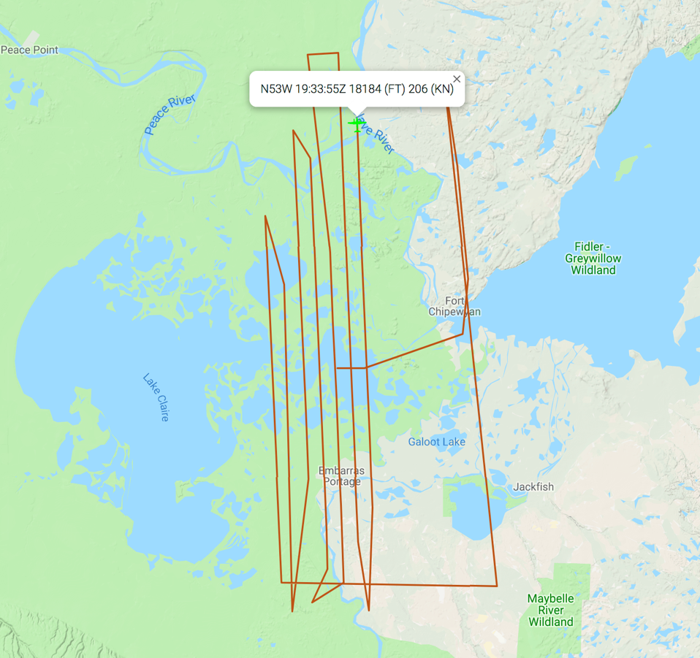
15 July 2019/DOY 196 Peace-Athabasca Delta
Peace-Athabasca Delta
Planned Flight Lines
Peace-Athabasca Delta
As-Flown Lines
Notes:
Blue points are the 2018 sampling locations from the Smith-Pavelsky team. Butman team joining them in 2019

Slide 9
15 July 2019/DOY 196 Peace-Athabasca Delta
AVIRIS-NG Quick-look products
https://avirisng.jpl.nasa.gov/cgi/flights.cgi?step=view_flightlog&flight_id=ang20180721t
A. Line 325A-D, FL183, Run ID 183446: Chalkyitsik – Porcupine River
B. Line 325A-D, FL183, Run ID 201426 : Chalkyitsik – Porcupine River - reverse
A
Update
B
A. A bit of fogging on lower edge of image
B. Popcorn clouds and orthorectification glitch near left edge

Slide 10
Backup

Slide 11
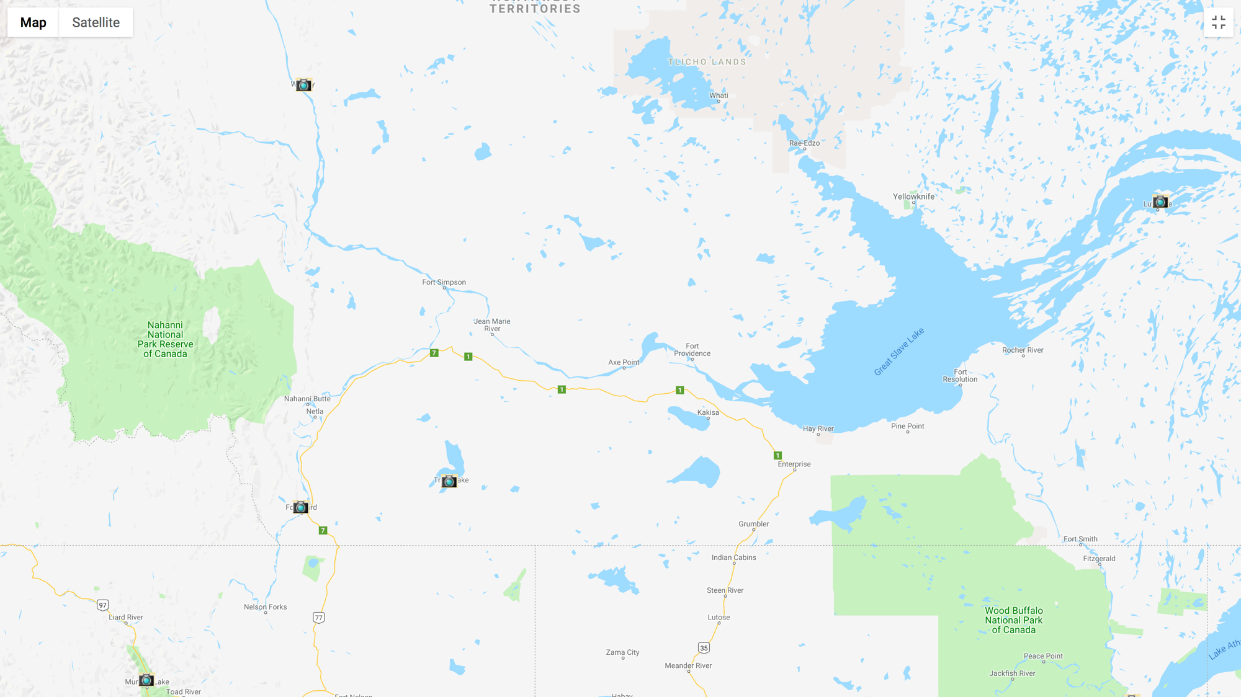
Camera Locations
Wrigley
Trout
Lake
Fort
Liard

Slide 12
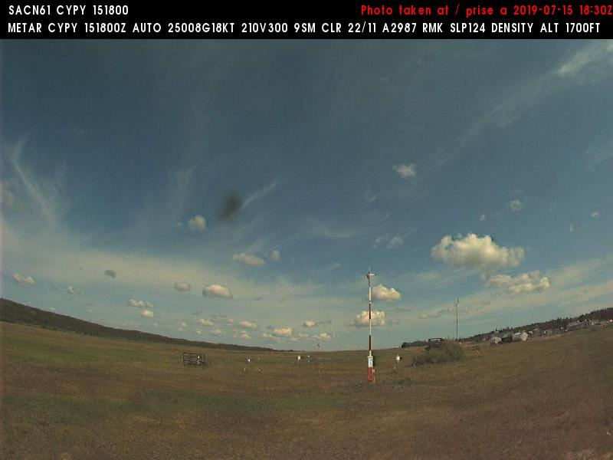
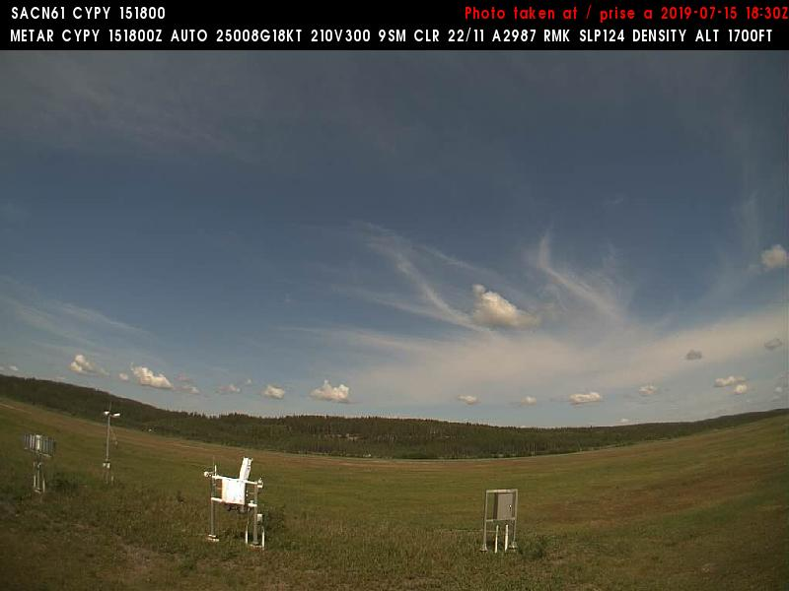
15 July 2019/DOY 196 Peace-Athabasca Delta
Fort Chipewyan (CYPY) N58 46 02 W111 07 02
1230 MDT/1830 UTC
Northeast
Northwest
Notes:
Taken during the time of data acquisition over PAD
Fort Chipewyan is in the middle of the PAD grid

Slide 13
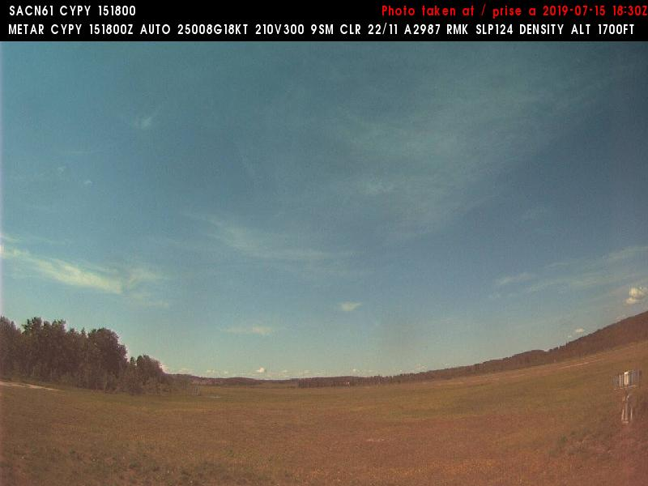
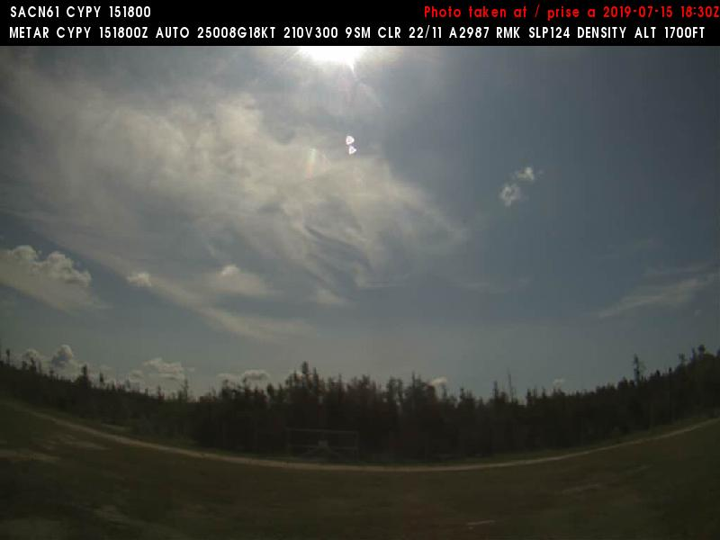
15 July 2019/DOY 196 Peace-Athabasca Delta
Fort Chipewyan (CYPY) N58 46 02 W111 07 02
1230 MDT/1830 UTC
West
Southeast
Notes:
Taken during the time of data acquisition over PAD
Fort Chipewyan is in the middle of the PAD grid

